Slide 1
CSE7301 - INTERNSHIP Final Review Presentation Automation of Payroll Processes: Enhancing Efficiency and Accuracy through Technology
Student Details
Name | KRUTHIKA K
Roll No | 20211CIT0105
Section | 08-CIT-01
Batch No. | CSE_CIT_CAP_37
Under the Supervision of,
MR.Tanveer Ahmed
Assistant professor
School of Computer Science and Engineering
Presidency University
Name of the Program: B.TECH/COMPUTER SCIENCE AND ENGINEERING(INTERNET OF THINGS)
Name of the HoD: DR.ANANDRAJ S P
Name of the Program Project Coordinator: DR. SHARMASTH VALI
Name of the School Internship/Project Coordinators: Mr. Md Ziaur Rahman /
Dr. Sampath A K / Dr. Abdul Khadar A

Slide 2
Content
About Company or Organization
Working domain or the technology
About your team and reporting Manager
Challenges Faced in Internship
Objectives of the work
Literature Review
Proposed System
Problem Statement
System Requirements
Advantages of Proposed System/Work
Internship Roadmap
Github Link

Slide 3
About Company : Toyota Kirloskar Motor Pvt. Ltd.
Toyota Kirloskar Motor (TKM) is Toyota’s Indian arm, a joint venture between Toyota Motor Corporation (Japan) and Kirloskar Group (India). Since its establishment in 1997, TKM has been producing some of the most reliable and fuel-efficient cars on Indian roads. Based in Bidadi, Karnataka, the company is known for its focus on quality, innovation, and sustainability.
Key Highlights :-
Industry: Automotive Manufacturing
Manufacturing Plants: Two plants in Bidadi , with a capacity of 3,10,000+ units per year
Technology Focus: AI, RPA, ERP-based automation, and sustainability initiatives
Employee Strength: 7,000+ employees

Slide 4
Products:
TKM produces a wide range of passenger and commercial vehicles, known for reliability, fuel efficiency, and advanced technology.
Some key models include:-
Sedans: Toyota Camry, Toyota Vellfire
SUVs & MPVs: Toyota Fortuner, Toyota Innova HyCross, Toyota Hyryder - Hatchbacks: Toyota Glanza.
Hybrid & Electric Vehicles: Toyota Urban Cruiser Hyryder (Strong Hybrid), Toyota Camry Hybrid
Commercial Vehicles: Toyota Hilux (Pick-up truck)

Slide 5
Clients & Market Presence:
Everyday Drivers – People who want reliable, low-maintenance cars that last for years.
Corporates & Government – Companies and government bodies that trust Toyota for their fleet needs.
Adventure & Utility Buyers – Customers looking for durable, tough vehicles like the Hilux and Fortuner.
Eco-Conscious Buyers – Those who prefer hybrid technology for fuel efficiency and lower emissions.

Slide 6
Working domain : HR Core(Automation)
The HR Core domain at Toyota Kirloskar Motor (TKM) is responsible for managing all human resource operations, including payroll, attendance, employee benefits, performance management, and compliance.
Payroll is one of the most critical functions in HR, ensuring timely salary disbursement, tax compliance, and financial accuracy for employees. However, manual payroll operations lead to inefficiencies, which is why automation is essential. Here as an intern my role is to collect analyses HR data processes, and find software solution. Identifying manual HR tasks that can be replaced with digital workflows. Ai-driven payroll Automation can be developed that reduces work delays.

Slide 7
About your team and reporting Manager
OBJECTIVE:
To enhance payroll efficiency by automating manual processes, reducing delays, and ensuring compliance through technology-driven solutions.
Team members:
Name:Kruthika k
Team mentor : Mr. Shivaraj omkari
Reporting Manager:
Mr. Sunil Naik

Slide 8
Challenges Faced in Internship
Adapting to Toyota’s Strict Work Culture
Understanding Complex Manufacturing Processes
Performance Pressure & High Expectations
Problem-Solving & Kaizen Implementation

Slide 9
Objectives of the work
1. Eliminate HR Dependency and Enable Employee Self-Service.
2. To develop a Secure, Scalable, and Cross-Platform Payroll Management System.
3. To Integrate with Existing Systems Like Toyota Mithra for Seamless Access
4. To Implement Multi-Factor Authentication (MFA) and OTP-Based Password Recovery
5. To Automate Payroll Data Validation and Ensure Data Integrity
6. Improve Transparency and Audit-Readiness of Payroll Records
7. To Enhance Communication through Real-Time Notifications and Alerts
8. To Reduce Operational Costs and Improve Administrative Efficiency

Slide 10
Literature Review
Author(s) | Title | Year | Technology Used | Drawback | Functionality | Results
Ali H. Y. Mohammed, Rudzidatul A. Dziyauddin, Liza A. Latiff | Current Multi-Factor Authentication: Approaches, Requirements, Attacks and Challenges | 2023 | Biometric and non-biometric MFA techniques | Balancing security and accuracy remains challenging | Discusses various MFA approaches and their effectiveness in enhancing security | Highlights the need for a trade-off between security and user convenience in MFA implementations
Sajid Iqbal, Saeed Ullah Jan, Asad Ullah | Secure Login System | 2023 | One-time password (OTP), hashing, two-factor authentication (2FA), QR code | Potential complexity in implementation and user adoption | Proposes an enhanced login authentication system incorporating OTP, hashing, 2FA, and QR codes | Aims to improve security by adding multiple authentication layers
Palo Alto Networks | 8 Trends Reshaping Network Security in 2025 | 2024 | Cloud-Delivered Security Services (CDSS) powered by Precision AI | Implementation complexity and resource requirements | Discusses emerging trends in network security | Identifies key areas of focus for future security measures
Solutions Review Editors | 74 Cybersecurity Predictions from Industry Experts for 2025 | 2024 | Various cybersecurity technologies | Broad scope may lack specific actionable insights | Compiles expert opinions on future cybersecurity trends | Provides a comprehensive overview of anticipated security challenges
Forbes Technology Council | Securing The Future: The Most Critical Cybersecurity Trends Of 2023 | 2023 | Cloud security, IoT security, ransomware protection | Shared responsibility models can lead to security gaps | Highlights critical cybersecurity threats and mitigation strategies | Emphasizes the importance of proactive security measures
Gartner | 4 Exciting New Trends in the Gartner Emerging Technologies Hype Cycle | 2023 | Internal developer portals, GitOps, open-source program offices | Emerging technologies may face adoption hurdles | Identifies and analyzes emerging technologies in the industry | Provides guidance on potential impacts of new technologies
Frontier Enterprise Staff Writer | The 2025 Cybersecurity Predictions Bonanza | 2024 | Blockchain technology, AI in security | Overhyped AI capabilities may not meet expectations | Discusses future cybersecurity trends and technologies | Offers predictions on the evolution of cybersecurity practices

Slide 11
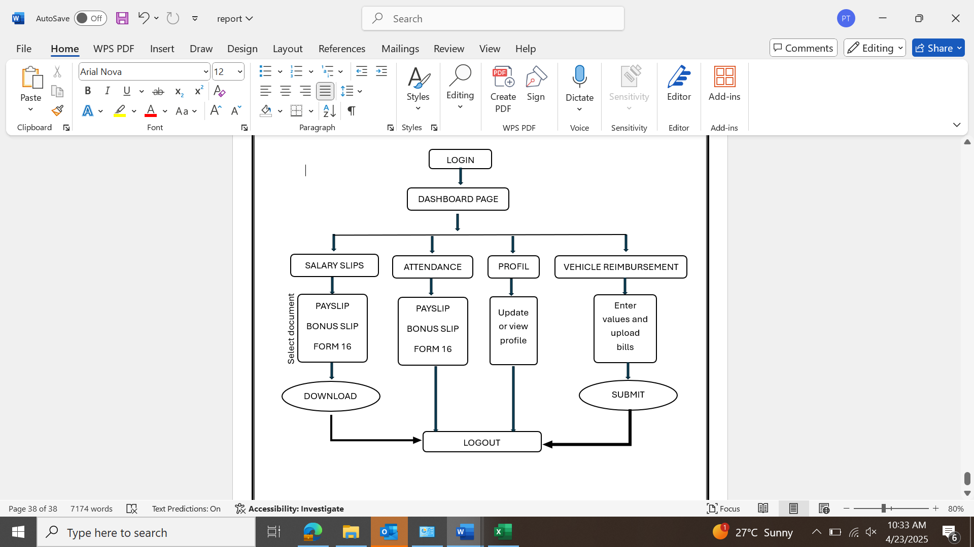
Proposed System / Work

Slide 12
Proposed System / Work
The system is a secure web application that allows employees to:
Log in using Employee ID and password.
Authenticate via OTP-based MFA sent to registered email.
Download any month's document securely - Use JWT for session management and AES-256 encryption for document storage.
Vehicle reimbursement automation.
In the future, integrate with the Toyota Mithra app for a seamless experience.

Slide 13
Problem Statement
Employees without Oracle access receive their payslips via email, but these emails can be lost or deleted.
As a result, employees frequently request HR to resend their payslips, creating inefficiencies and waste of time.
A self-service, secure web application is needed to allow employees to access their documents independently while ensuring security and confidentiality.

Slide 14
System Requirements
Backend: Flask (Python), SQLite/MySQL
Frontend: HTML, CSS, JavaScript
Security Features:
JWT Authentication for secure user sessions
AES-256 Encryption for document storage
HTTPS for secure data transmission
Flask-Mail for OTP-based MFA
Storage: Secure document management system for payslips, bonus forms, and Form 16

Slide 15
Outcomes:
1.Enhanced Payroll Accessibility and Transparency
2.Automation and Streamlining of HR Operations
3.Streamlined Vehicle Reimbursement Process
4.Centralized Employee Profile Management
5. Cross-Platform and Mobile-Optimized Design
6. Secure and Compliant Data Handling
7.Enhanced Employee Experience and Satisfaction
8. Strategic Insights and Reporting for HR
9. Seamless Integration with Toyota Mithra App

Slide 16
Advantages of Proposed System/Work
Secure login and authentication (MFA + JWT Authentication + Encryption).
Employees do not have to depend on their mails as self service platform is created.
It can be accessed anytime / anywhere .
It saves time for both employees and the payroll teams . This automation reduces HR workload.

Slide 17

Internship Road Map
Note: Write in the below table what u will be achieving in each review
PHASE | TASK | FEB | MAR | APR
Phase 1: Planning and design | Requirement analysis and gathering information.
Phase 2: Development(backend) | Flask back-end setup, Authentication(OTP) -API for salary slips -Attendance and reimbursement logic
Phase 3: Development (front end) | -Flutter UI -Overall dashboard setup
Phase 4: Testing and deployment | -Deployment server -security testing

Slide 18
Github Link
https://github.com/kruthika0720/INTERNSHIP.git

Slide 19
Thank you !!

